Slide 1

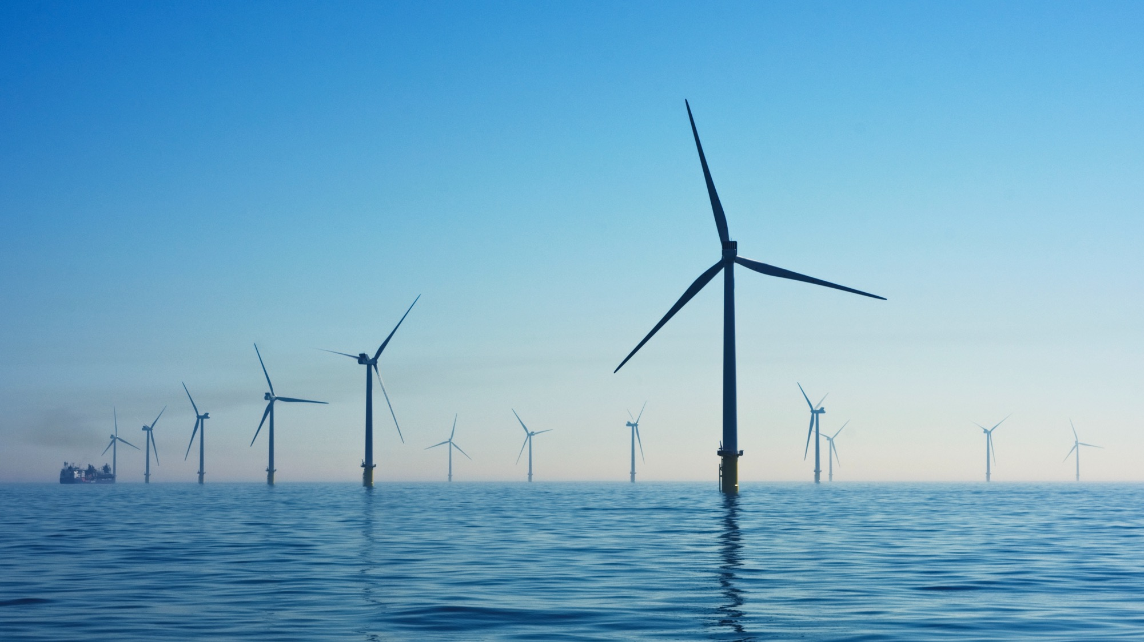

GHG Emissions
& Carbon
Reduction Plan
Reporting period:
31 December 2025
Vaccination UK Limited
This report details Vaccination UK Limited’s GHG emissions and their reduction plan.
This carbon reduction plan is compliant with PPN 006.
03/09/2026

Slide 2

Contents
Introduction | …3
GHG Emissions Methodology | …4
GHG Emissions Summary | …5
Emissions Reduction Target | …6
Carbon Reduction Initiatives | …7
Declaration and Sign Off | …8

Slide 3

Introduction
3
Company name:
Publication date:
Reporting period:
Vaccination UK Limited
03/09/2026
1 January 2022 - 31 December 2025
Commitment to target Net Zero:
2040
2045
Vaccination UK Limited is an NHS-commissioned provider of school-aged immunisation services, established in the UK in 2007 and headquartered at Portmill Lane, Hitchin. Commissioned by NHS England since 2015, it delivers flu, HPV, MMR, MenACWY and Td/IPV programmes in schools and community catch-up clinics across North London, the East of England, Bedfordshire, Luton and Milton Keynes, the West Midlands, and Humber and Yorkshire.
The company publishes a Carbon Reduction Plan in line with NHS supplier requirements, aligning to the NHS target of net zero by 2045. It is rated Good by the Care Quality Commission, with clinical governance for NHS-commissioned programmes led by its Clinical Director. Social value sits in prevention - a seasonal flu vaccination carries an estimated carbon footprint over 14 times smaller than treating a case of influenza - while principal emissions exposure lies in the mobile delivery model: nurse travel between school sites, clinical consumables and cold-chain vaccine storage.

Slide 4
GHG Emissions Methodology
4
Baseline emissions are a record of the greenhouse gases that have been produced in the past and were produced prior to the introduction of any strategies to reduce emissions. Baseline emissions are the reference point against which emissions reduction can be measured.
Vaccination UK Limited’s emissions have been calculated against a baseline year of 2022.
Vaccination UK Limited’s GHG emissions inventory is aligned to the GHG Protocol and covers:
Scope 3: Supply chain emissions and categories
These have been calculated using spend based data except for Employee commuting where a distance-based method is used depending on the data available.
Scope 3 GHG Category | Description
Category 1: Purchased goods and Services | Emissions from the production of goods and services a company buys.
Category 2: Capital goods | Emissions from producing long-term assets such as buildings or equipment.
Category 3: Fuel and Energy-Related (not in Scopes 1 or 2) | Emissions from extraction, production, and transportation of fuels and energy purchased.
Category 4: Upstream Transportation and Distribution | Emissions from transporting and distributing products purchased by the reporting company.
Category 5: Waste Generated in Operations | Emissions from waste disposal and treatment.
Category 6: Business Travel | Emissions from travel by employees (e.g., flights, rental cars).
Category 7: Employee Commuting | Emissions from employees commuting to and from work.
Category 8: Upstream Leased Assets | Emissions from leased assets not included in Scope 1 or 2, occurring upstream in the value chain.
Category 9: Downstream Transportations & Distributions | Emissions from transporting and distributing sold products to customers.
Category 10: Processing of Sold Products | Emissions from processing intermediate products sold by the company.
Category 11: Use of Sold Products | Emissions from the use of goods and services sold.
Category 12: End of Life of Sold Products | Emissions from waste disposal and treatment of sold products at their end-of-life.
Category 13: Downstream Leased Assets | Emissions from assets leased to other entities.
Category 14: Franchises | Emissions from operations of franchises.
Category 15: Investments | Emissions from investments made by the company, such as loans and equity.
Scope 1: Direct emissions
Direct emissions from sources owned or controlled by an organization, such as fuel combustion in company vehicles, manufacturing processes, and onsite energy production.
Scope 2: Indirect emissions
Indirect emissions from the consumption of purchased electricity, steam, heating, and cooling. These emissions occur at the source of energy production but are attributed to the organization that uses the energy.

Slide 5
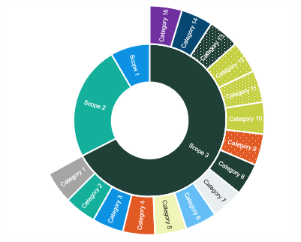
GHG Emissions Summary
5
Scope | GHG Category | 2022 Tonnes CO2e (Baseline) | 2025 Tonnes CO2e (Current) | 2025 % of emissions
1 | Direct fuel | 13.9 | 22.2 | 2.21%
 | Fuel in company vehicles | Not relevant | Not relevant | Not relevant
2 | Electricity – location based | 38.3 | 14.5 | 1.45%
 | Indirect fuel usage in leased assets | Not relevant | Not relevant | Not relevant
 | Indirect fuel usage in leased offices | Not relevant | Not relevant | Not relevant
3 | Category 1: Purchased goods and Services | 317.3 | 201.2 | 20.05%
 | Category 2: Capital goods | 67.6 | 7.0 | 0.70%
 | Category 3: Fuel and Energy-Related (not in Scopes 1 or 2) | Not relevant | 62.3 | 6.21%
 | Category 4: Upstream Transportation and Distribution | Not relevant | Not relevant | Not relevant
 | Category 5: Waste Generated in Operations | 7.0 | 62.7 | 6.24%
 | Category 6: Business Travel | 232.3 | 212.7 | 21.19%
 | Category 7: Employee Commuting | 117.6 | 421.2 | 41.96%
 | Category 8: Upstream Leased Assets | 19.3 | Not relevant | %
 | Category 9: Downstream Transportations & Distributions | Not relevant | Not relevant | Not relevant
 | Category 10: Processing of Sold Products | Not measured | Not measured | Not measured
 | Category 11: Use of Sold Products | Not measured | Not measured | Not measured
 | Category 12: End of Life of Sold Products | Not measured | Not measured | Not measured
 | Category 13: Downstream Leased Assets | Not relevant | Not relevant | Not relevant
 | Category 14: Franchises | Not measured | Not measured | Not measured
 | Category 15: Investments | Not measured | Not measured | Not measured
 | Total Emissions | 813.4 | 1,003.8
The footprint calculated is reliant on the data provided. Flotilla do not provide assurance or verification of the data collected.
Downstream Scope 3 categories are outside the scope of this engagement and are indicated as 'not measured.'
Scope 1
Scope 2
Scope 3
22
15
967
tCO2e
tCO2e
tCO2e
2.2% of Total
1.4% of Total
96.3% of Total
1004
Current tCO2e

Slide 6
Emissions Reduction Target
6
We have committed to reduce emissions in line with science-based targets. We project that carbon emissions will decrease over the next five years to 456 tCO2e by 2031. This is a reduction of 54.6%. Progress against our targets can be seen in the graph to the right.
Annual reduction percentage required to achieve Net Zero:
10.9%

Slide 7
Carbon Reduction Initiatives
7
To reduce Scope 1 and 2 emissions Vaccination UK Limited plans to:
To reduce Scope 3 emissions Vaccination UK Limited plans to:
Replace gas boiler with low carbon heating and hot water systems (Direct fuel, Category 13: Downstream leased assets)
Encourage car-sharing for business meetings (in employee owned cars) (Category 6: Business travel)
Implement an office energy efficiency policy (Electricity, Category 8: Upstream leased assets)
Switch to a renewable energy tariff (Electricity, Category 13: Downstream leased assets, Category 8: Upstream leased assets)
Issue a sustainability supplier questionnaire to your postage suppliers (Category 1: Purchased goods and services)
Scope 1: Direct emissions
Replace gas boiler with low carbon heating and hot water systems (Direct fuel, Category 13: Downstream leased assets)
Other initiatives that Vaccination UK Limited plans to do that are not specific to Scope 1, 2 or 3:
Collate an evidence pack throughout data collection (Governance & strategy)
Understand carbon accounting & net zero key terms and methodologies (Employee Engagement)
Create an employee-led green team (Employee Engagement)
Provide comprehensive training for your sustainability lead (Employee Engagement)
Adopt levers to reduce business travel emissions (Governance & strategy)
Scope 2: Indirect emissions
Choose a higher-quality renewable tariff (Electricity)
Implement an office energy efficiency policy (Electricity, Category 8: Upstream leased assets)
Switch to a renewable energy tariff (Electricity, Category 13: Downstream leased assets, Category 8: Upstream leased assets)
Completed Carbon Reduction Initiatives
The following environmental management measures and projects have been completed or implemented prior to the first GHG inventory calculation, demonstrating Vaccination UK Limited’s commitment to reduction. As this was prior to the baseline, there are no associated emissions recorded.
Identify and engage climate champions within your organisation
Issue the Employee Survey
Complete the Data Collection spreadsheet

Slide 8
Declaration and Sign Off
8
This Carbon Reduction Plan has been completed in accordance with PPN 006 and associated guidance and reporting standard for Carbon Reduction Plans.
Emissions have been reported and recorded in accordance with the published reporting standard for Carbon Reduction Plans and the GHG Reporting Protocol corporate standard¹ and uses the appropriate Government emission conversion factors for greenhouse gas company reporting.²
Scope 1 and Scope 2 emissions have been reported in accordance with SECR requirements, and the required subset of Scope 3 emissions have been reported in accordance with the published reporting standard for Carbon Reduction Plans and the Corporate Value Chain (Scope 3) Standard.³
This Carbon Reduction Plan has been reviewed and signed off by the board of directors (or equivalent management body).
Vaccination UK Limited
Signature:
Signed by:
Position:
Director
Date:
03/09/2026
1 https://ghgprotocol.org/corporate-standard
2 https://www.gov.uk/government/collections/government-conversion-factors-for-company-reporting
3 https://ghgprotocol.org/standards/scope-3-standard

Slide 9



Produced by Flotilla on behalf of Vaccination UK Limited
flotillagroup.com

