Slide 1

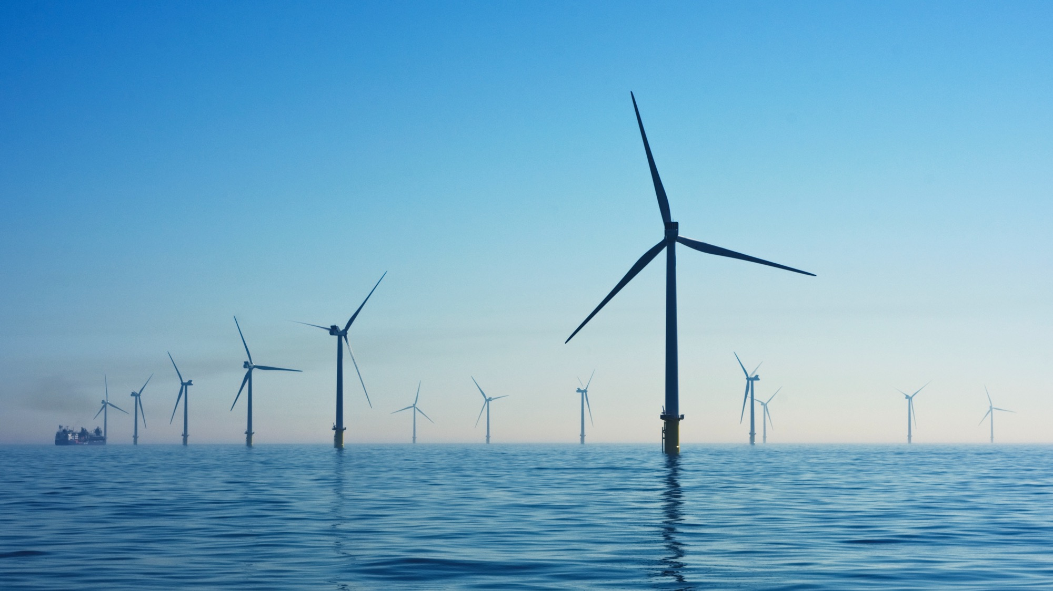

GHG Emissions
& Carbon
Reduction Plan
Vaccination UK Limited
This report details Vaccination UK Limited’s GHG emissions and their reduction plan.
This carbon reduction plan is compliant with PPN 06/21.
2024

Slide 2

Contents
Introduction | …3
GHG Emissions Methodology | …4
GHG Emissions Summary | …5
Emissions Reduction Target | …6
Carbon Reduction Initiatives | …7
Declaration and Sign Off | …8

Slide 3

Introduction
3
Company name:
Publication date:
Reporting period:
Vaccination UK Limited
December 2025
1 January 2022 - 31 December 2024
Commitment to target Net Zero:
2040
2045
Vaccination UK Limited is a specialist healthcare provider delivering vaccination services to the public across a range of clinical settings. The organisation offers a comprehensive portfolio of vaccinations, including seasonal influenza, HPV and travel-related immunisations, supporting public health outcomes through safe, accessible and high-quality clinical care delivered by a highly qualified healthcare workforce.
As a healthcare provider operating within a regulated and resource-intensive environment, Vaccination UK recognises its responsibility to minimise its environmental impact while continuing to deliver essential services. The organisation is committed to embedding sustainability into its operations, governance and decision-making, and to understanding and managing the greenhouse gas emissions associated with its activities.
This Carbon Reduction Plan sets out Vaccination UK’s commitment to achieving Net Zero greenhouse gas emissions by 2045. It provides transparency on the organisation’s baseline and current emissions, calculated in line with the Greenhouse Gas Protocol and relevant UK Government guidance, and identifies key sources of emissions across Scope 1, Scope 2 and relevant Scope 3 categories. The Plan also outlines existing environmental management measures and future actions designed to reduce emissions, engage employees, and support continuous improvement in environmental performance.
Through this approach, Vaccination UK aims to demonstrate accountability, support national net zero objectives, and contribute positively to the transition towards a low-carbon healthcare sector.

Slide 4
GHG Emissions Methodology
4
Baseline emissions are a record of the greenhouse gases that have been produced in the past and were produced prior to the introduction of any strategies to reduce emissions. Baseline emissions are the reference point against which emissions reduction can be measured.
Vaccination UK Limited’s emissions have been calculated against a baseline year of 2022.
Vaccination UK Limited’s GHG emissions inventory is aligned to the GHG Protocol and covers:
Scope 3: Supply chain emissions and categories
These have been calculated using spend based data except for Employee commuting where a distance-based method is used depending on the data available.
Scope 3 GHG Category | Description
Category 1: Purchased goods and Services | Emissions from the production of goods and services a company buys.
Category 2: Capital goods | Emissions from producing long-term assets such as buildings or equipment.
Category 3: Fuel and Energy-Related (not in Scopes 1 or 2) | Emissions from extraction, production, and transportation of fuels and energy purchased.
Category 4: Upstream Transportation and Distribution | Emissions from transporting and distributing products purchased by the reporting company.
Category 5: Waste Generated in Operations | Emissions from waste disposal and treatment.
Category 6: Business Travel | Emissions from travel by employees (e.g., flights, rental cars).
Category 7: Employee Commuting | Emissions from employees commuting to and from work.
Category 8: Upstream Leased Assets | Emissions from leased assets not included in Scope 1 or 2, occurring upstream in the value chain.
Category 9: Downstream Transportations & Distributions | Emissions from transporting and distributing sold products to customers.
Category 10: Processing of Sold Products | Emissions from processing intermediate products sold by the company.
Category 11: Use of Sold Products | Emissions from the use of goods and services sold.
Category 12: End of Life of Sold Products | Emissions from waste disposal and treatment of sold products at their end-of-life.
Category 13: Downstream Leased Assets | Emissions from assets leased to other entities.
Category 14: Franchises | Emissions from operations of franchises.
Category 15: Investments | Emissions from investments made by the company, such as loans and equity.
Scope 1: Direct emissions
Direct emissions from sources owned or controlled by an organization, such as fuel combustion in company vehicles, manufacturing processes, and onsite energy production.
Scope 2: Indirect emissions
Indirect emissions from the consumption of purchased electricity, steam, heating, and cooling. These emissions occur at the source of energy production but are attributed to the organization that uses the energy.

Slide 5
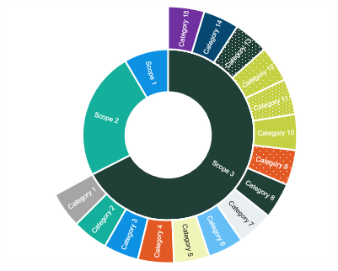
GHG Emissions Summary
5
Scope | GHG Category | 2022 Tonnes CO2e (Baseline) | 2024 Tonnes CO2e (Current) | 2024 % of emissions
1 | Fuel in company vehicles | Not Relevant | Not Relevant | Not Relevant
 | Direct fuel | 13.9 | 25.7 | 2.36%
2 | Electricity – location based | 38.3 | 69.6 | 6.40%
 | Indirect fuel usage in leased offices | Not Relevant | Not Relevant | Not Relevant
 | Indirect fuel usage in leased assets | Not Relevant | Not Relevant | Not Relevant
3 | Category 1: Purchased goods and Services | 317.3 | 240.3 | 22.09%
 | Category 2: Capital goods | 67.6 | 78.4 | 7.21%
 | Category 3: Fuel and Energy-Related (not in Scopes 1 or 2) | 0.0 | 101.0 | 9.28%
 | Category 4: Upstream Transportation and Distribution | Not Relevant | Not Relevant | Not Relevant
 | Category 5: Waste Generated in Operations | 7.0 | 29.9 | 2.75%
 | Category 6: Business Travel | 232.3 | 222.9 | 20.49%
 | Category 7: Employee Commuting | 117.6 | 320.2 | 29.43%
 | Category 8: Upstream Leased Assets | 19.3 | Not Relevant | n/a
 | Category 9: Downstream Transportations & Distributions | Not Relevant | Not Relevant | Not Relevant
 | Category 10: Processing of Sold Products | Not Relevant | Not Relevant | Not Relevant
 | Category 11: Use of Sold Products | Not Relevant | Not Relevant | Not Relevant
 | Category 12: End of Life of Sold Products | Not Relevant | Not Relevant | Not Relevant
 | Category 13: Downstream Leased Assets | Not Relevant | Not Relevant | Not Relevant
 | Category 14: Franchises | Not Relevant | Not Relevant | Not Relevant
 | Category 15: Investments | Not Relevant | Not Relevant | Not Relevant
 | Total Emissions | 813.4 | 1087.8
The footprint calculated is reliant on the data provided. Flotilla do not provide assurance or verification of the data collected.
Downstream Scope 3 categories are outside the scope of this engagement and are indicated as 'Not Relevant.'
Scope 1
Scope 2
Scope 3
26
70
993
tCO2e
tCO2e
tCO2e
2.4% of Total
6.4% of Total
91.2% of Total
1088
Current tCO2e

Slide 6
Emissions Reduction Target
6
We have committed to reduce emissions in line with science-based targets. We project that carbon emissions intensity will decrease to 37.5 tCO2e per £m turnover by 2030, representing a 50% reduction from our 2022 baseline of 75 tCO2e per £m. Our longer-term target is a 90% reduction by 2045, reaching 7.5 tCO2e per £m. From our current 2024 position of 59 tCO2e per £m, this requires a sustained year-on-year reduction of approximately 9.4%. Progress against our targets can be seen in the graph to the right.
Annual reduction percentage required to achieve Net Zero:
9.4%

Slide 7
Carbon Reduction Initiatives
7
To reduce Scope 1 and 2 emissions Vaccination UK Limited plans to:
To reduce Scope 3 emissions Vaccination UK Limited plans to:
Implement policy to prioritise office spaces electricity only energy supply at the conclusion of current leases. (Direct fuel, Category 13: Downstream leased assets)
Encourage car-sharing for business meetings (in employee owned cars) (Category 6: Business travel)
Implement an office energy efficiency policy (Electricity, Category 8: Upstream leased assets)
Issue a sustainability supplier questionnaire to your postage suppliers (Category 1: Purchased goods and services)
Scope 1: Direct emissions
Implement policy to prioritise office spaces electricity only energy supply at the conclusion of current leases. (Direct fuel, Category 13: Downstream leased assets)
Other initiatives that Vaccination UK Limited plans to do that are not specific to Scope 1, 2 or 3:
Collate an evidence pack throughout data collection (Governance & strategy)
Understand carbon accounting & net zero key terms and methodologies (Employee Engagement)
Create an employee-led green team (Employee Engagement)
Provide comprehensive training for your sustainability lead (Employee Engagement)
Adopt levers to reduce business travel emissions (Governance & strategy)
Scope 2: Indirect emissions
Implement policy to prioritise office spaces renewable energy supply at the conclusion of current leases.(Electricity, Category 13: Downstream leased assets, Category 8: Upstream leased assets)
Completed Carbon Reduction Initiatives
The following environmental management measures and projects have been completed or implemented prior to the first GHG inventory calculation, demonstrating Vaccination UK Limited’s commitment to reduction. As this was prior to the baseline, there are no associated emissions recorded.
Identify and engage climate champions within your organisation
Issue the Employee Survey
Complete the Data Collection spreadsheet

Slide 8
Declaration and Sign Off
8
This Carbon Reduction Plan has been completed in accordance with PPN 06/21 and associated guidance and reporting standard for Carbon Reduction Plans.
Emissions have been reported and recorded in accordance with the published reporting standard for Carbon Reduction Plans and the GHG Reporting Protocol corporate standard¹ and uses the appropriate Government emission conversion factors for greenhouse gas company reporting.²
Scope 1 and Scope 2 emissions have been reported in accordance with SECR requirements, and the required subset of Scope 3 emissions have been reported in accordance with the published reporting standard for Carbon Reduction Plans and the Corporate Value Chain (Scope 3) Standard.³
This Carbon Reduction Plan has been reviewed and signed off by the board of directors (or equivalent management body).
Signature:
Signed by:
Mikael Mulavassilis
Position:
Director
Date:
18/12/2025
1 https://ghgprotocol.org/corporate-standard
2 https://www.gov.uk/government/collections/government-conversion-factors-for-company-reporting
3 https://ghgprotocol.org/standards/scope-3-standard

Slide 9



Produced by Flotilla on behalf of Vaccination UK Limited
flotillaworld.com

